Slide 1
Leveraging Automatic Identification System

Slide 2
Challenges
Easy access
Verification
Answering question from Data

Slide 3
Easy Access
Providing resources to access the data

Slide 4
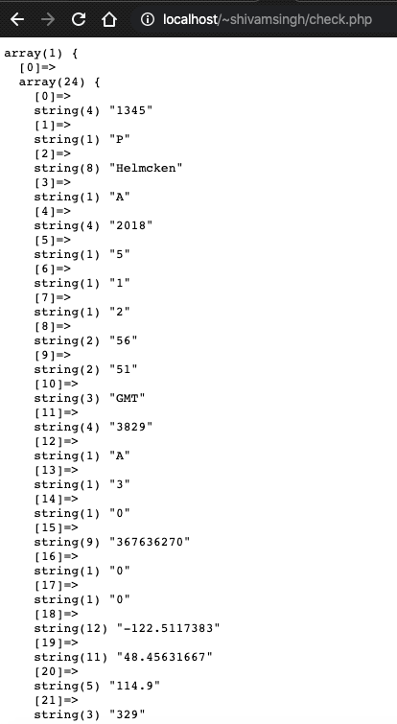
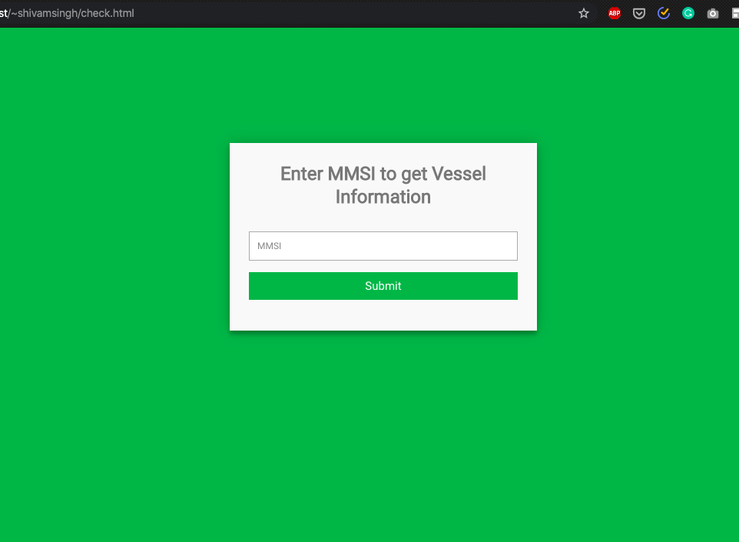

Slide 5
Verification
Is the data right?

Slide 6
Regular expression is the key.

Slide 7
Data is the Answer
Mining the data

Slide 8
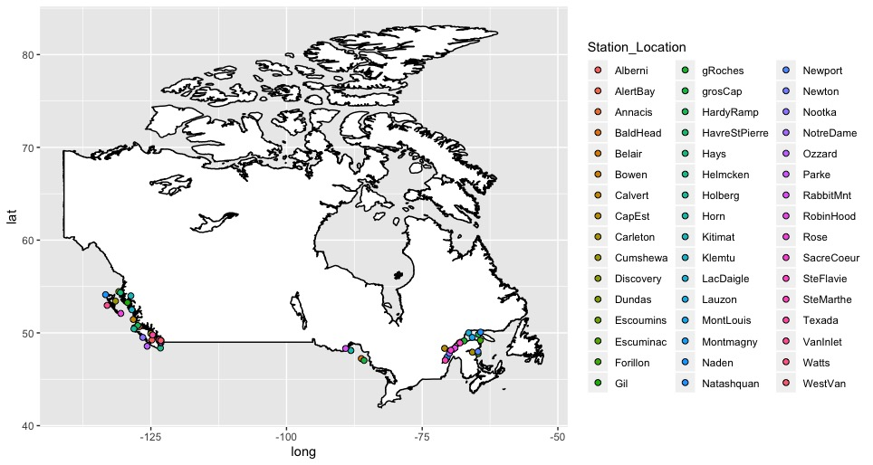
Mean station location

Slide 9
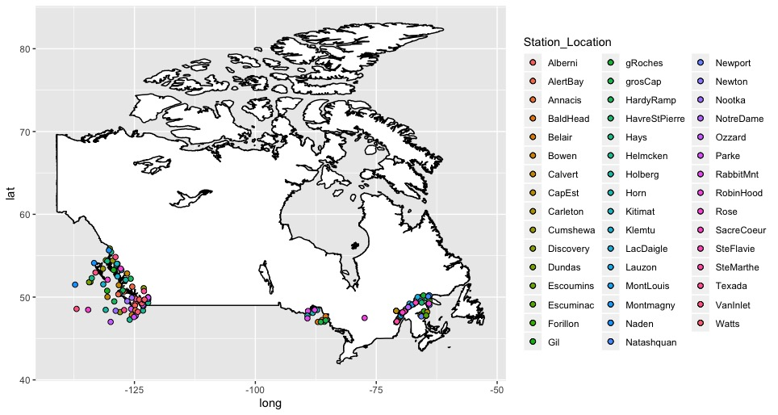
Min& max &mean

Slide 10
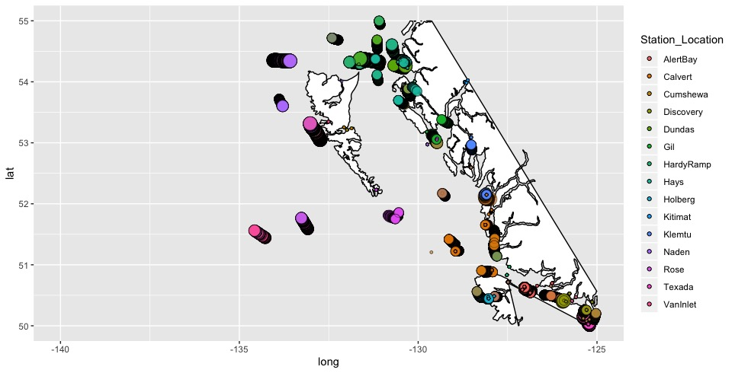
Density

Slide 11
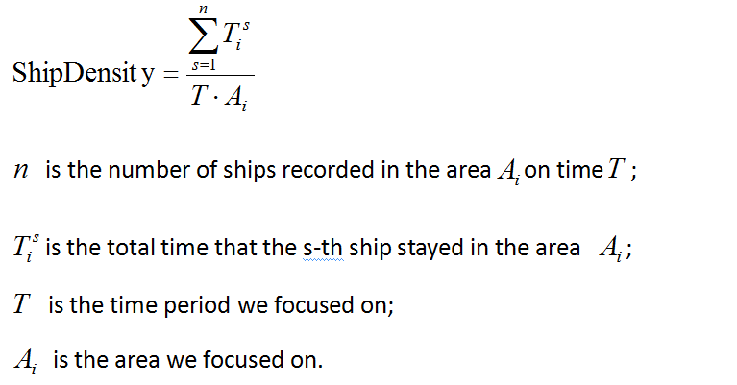
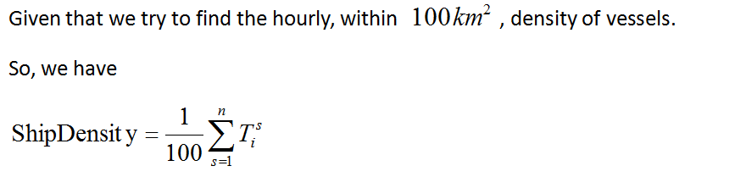
[1]Wu Lin, “Mapping Global Shipping Density from AIS Data”, Journal of Navigation 70(1):67-81.

Slide 12
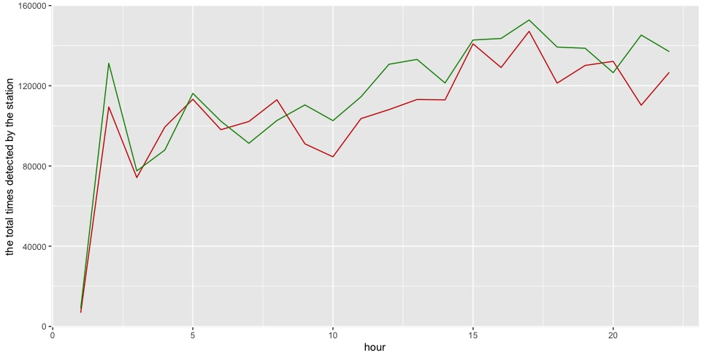
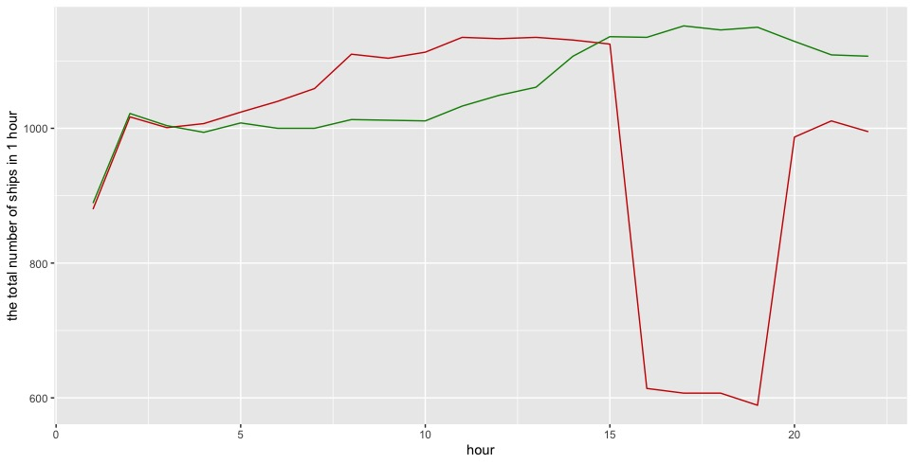

Slide 13
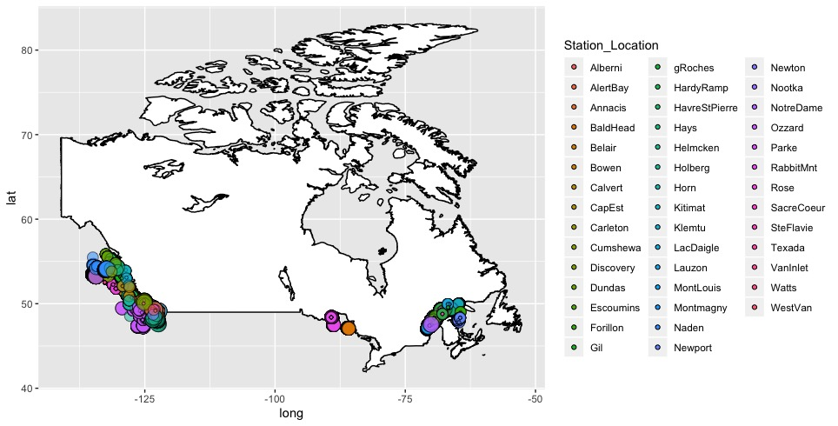
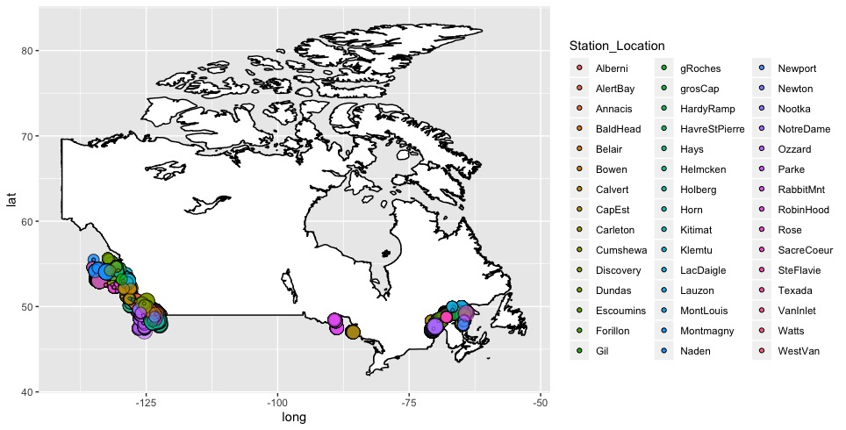
2018-05-01
h=14
h=15

Slide 14
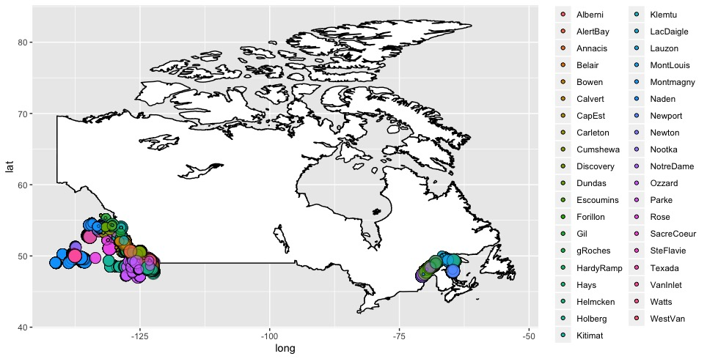
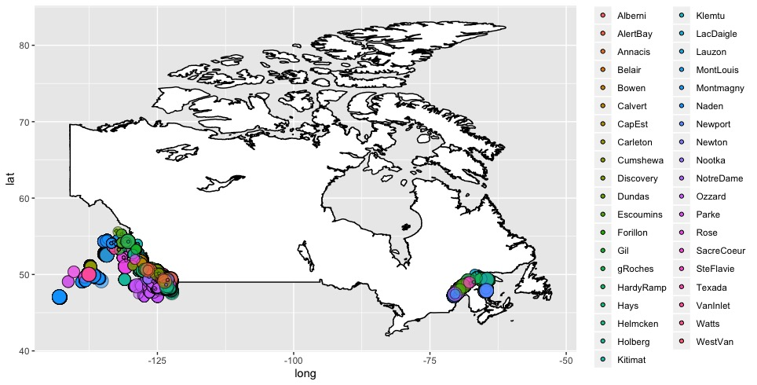
2018-05-02
H=14
H=15

Slide 15
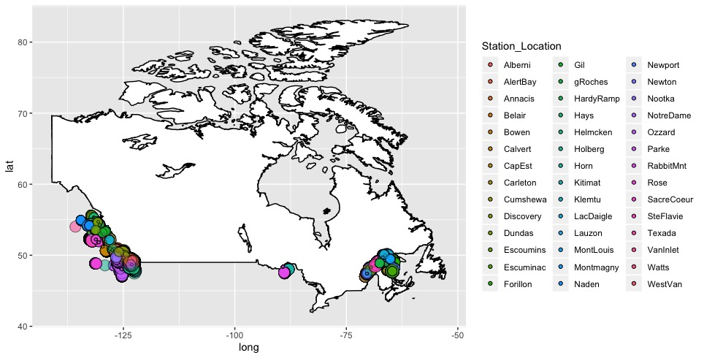
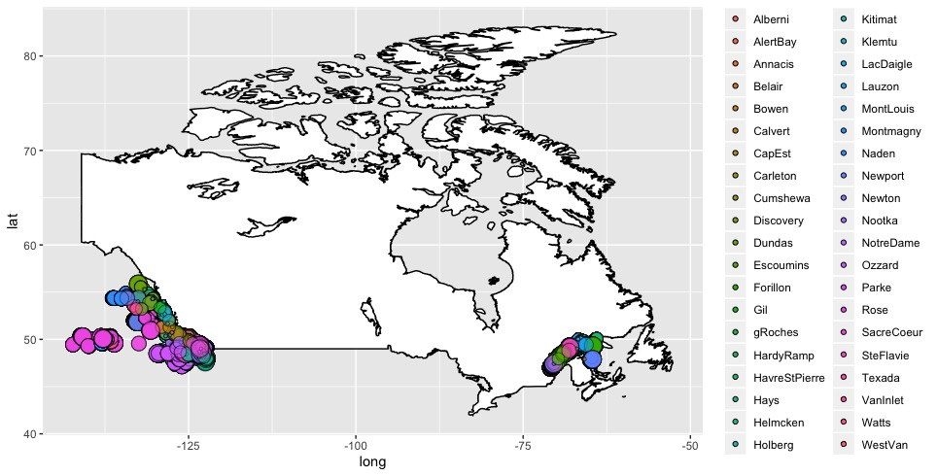
H=19
2018-05-01
2018-05-02

Slide 16
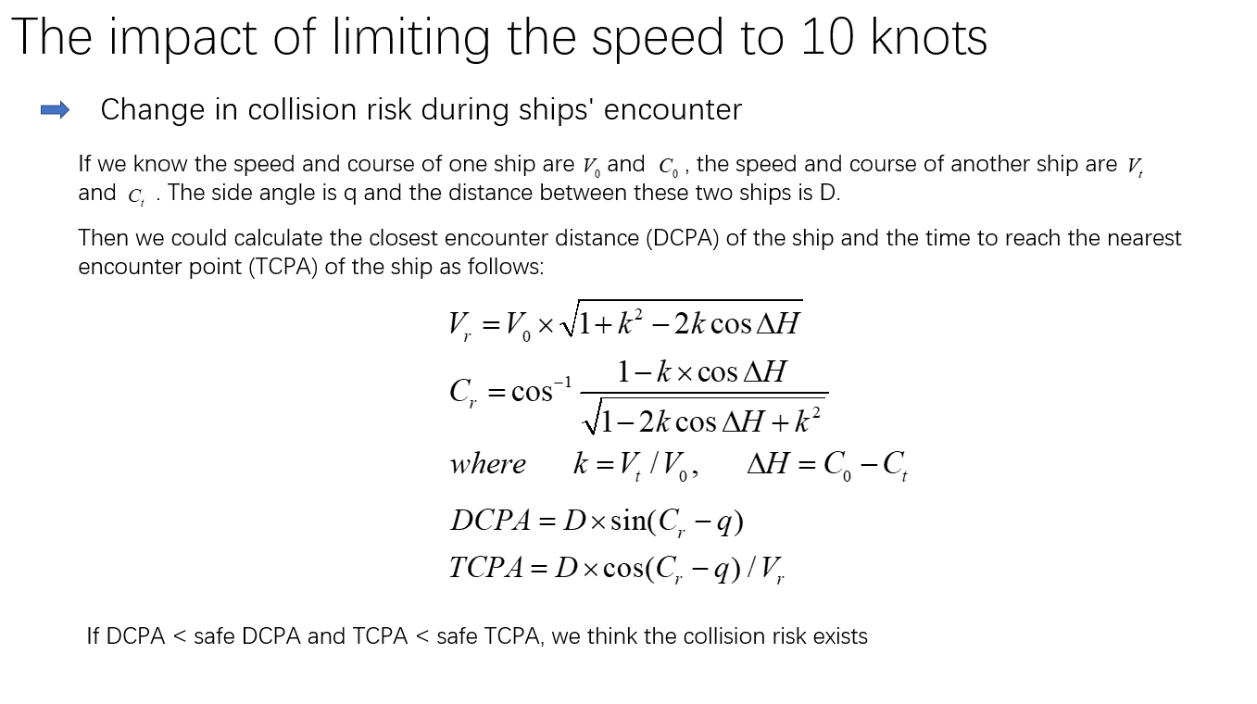

Slide 17
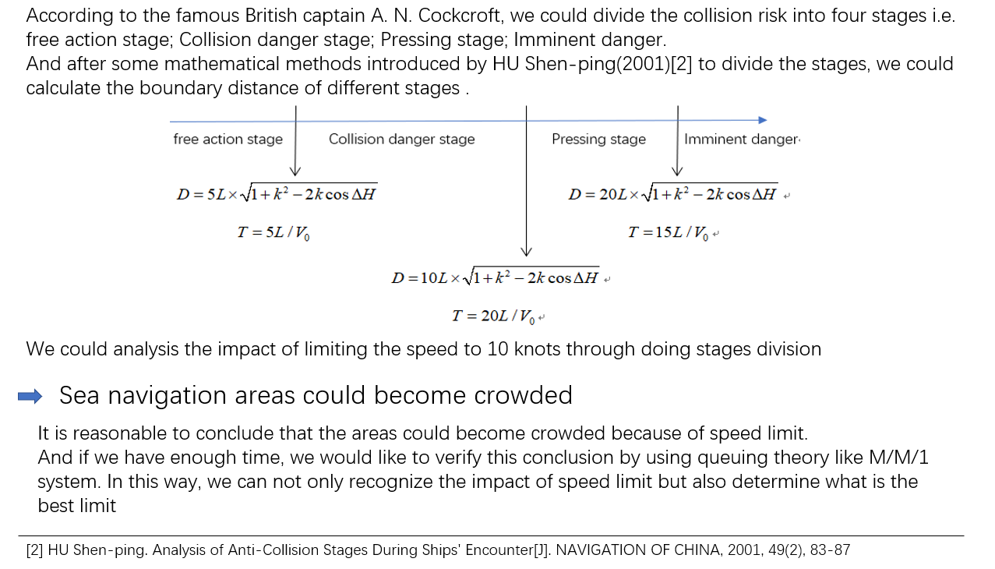

Slide 18
THANKS!
Team Members
👧 Xiaomeng Zhang
👦 Shivam Singh
👧 Vincy Wang
👧 Haitian Zhong

